Slide 1
Case Study 1 Morphine
Emily Gentles, Weiyi Liu,
Jack McCarthy, Qinzhe Wang

Slide 2
Introduction
Our drug of interest is Morphine
Used to relieve moderate to severe pain
May be habit forming, especially with prolonged use (MedlinePlus)
Aim of this study is to explore the relationship between the sale price per milligram of the diverted pharmaceutical substance Morphine and other reported factors
Location, reason for purchasing, time of purchase, etc
Data source: StreetRx

Slide 3
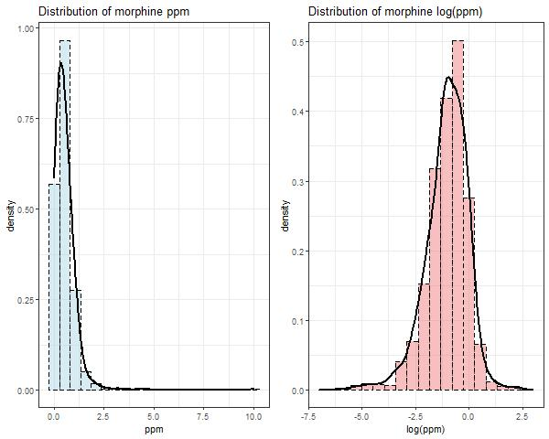
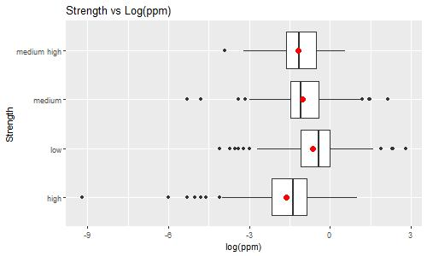
EDA
Distribution of ppm and log(ppm)
Strength = {low, medium, medium high, high}
Based on quantiles

Slide 4
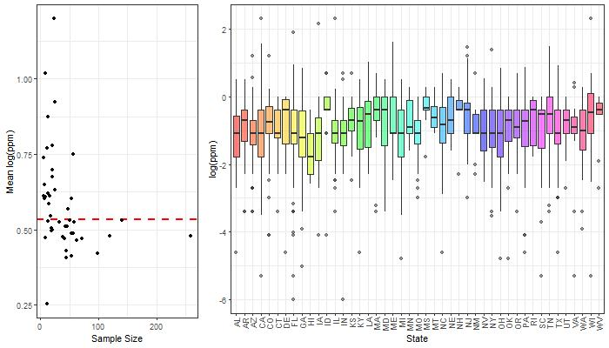
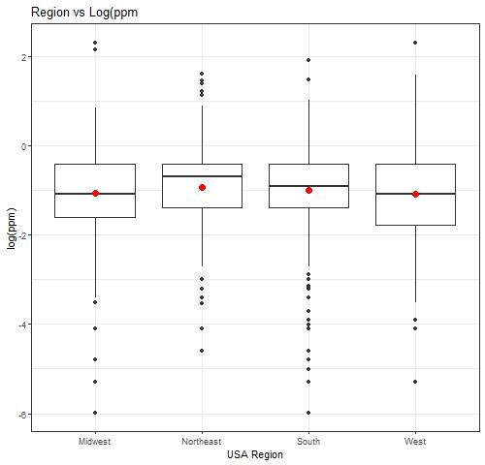
EDA
States with Smallest Sample Sizes
North Dakota | Vermont | DC | Wyoming | Alaska
1 | 1 | 1 | 1 | 2
State Sample Size vs Mean log(ppm)
Boxplot of log(ppm) by State

Slide 5
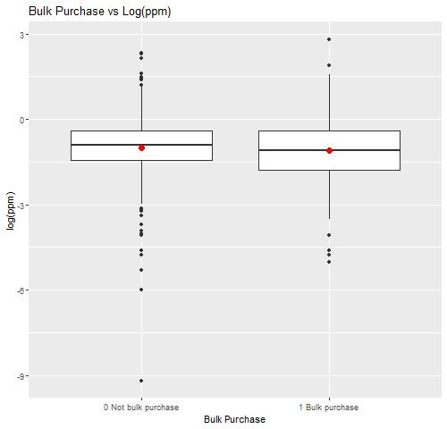
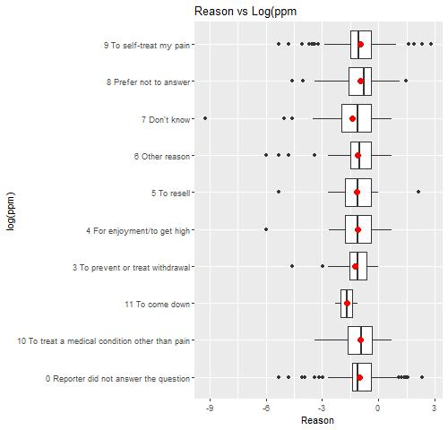
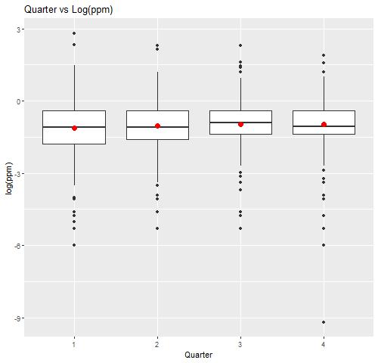
EDA

Slide 6
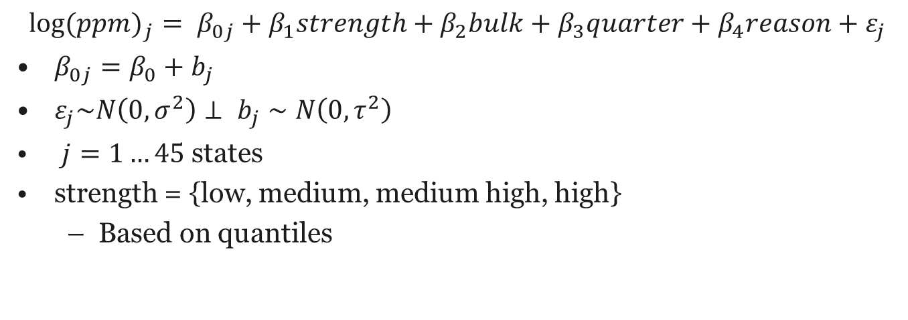
Model
$$\log{{(ppm)}_{j}}= β_{0j}+β_{1}strength+β_{2}bulk+β_{3}quarter+β_{4}reason+ε_{j}$$
$β_{0j}=β_{0}+b_{j}$
$ε_{j}\sim N\left(0,σ^{2}\right)⊥ b_{j}∼N\left(0,τ^{2}\right)$
$j=1…45$ states
strength = {low, medium, medium high, high}
Based on quantiles

Slide 7
Model Selection
Grouping | BIC
State | 5064.901
City | 5073.967
Region | 5072.387
Variable | P-Value
Source | 0.762
City | 0.515
Reason | 0.086
Quarter | 0.063
Strength | <2e-16
Bulk | 0.042

Slide 8
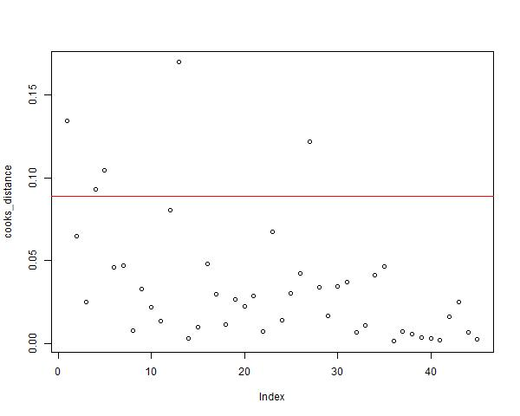
Model Assumptions
Independence
Unlikely to be fully met as a user of the website is likely to report multiple times within the same state
Constant Variance
Not met
Multiple states with high sample sizes such as CA are highly influential
Even when removing these states, this condition does not improve

Slide 9
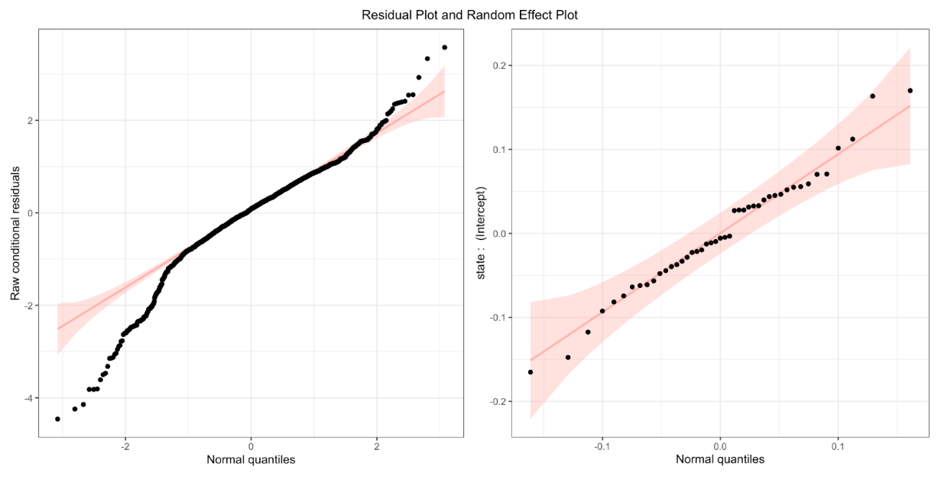
Model Assumptions
Normality
Slightly met
Heavy tails on both the left and right
Removed extreme outliers
Random effects seem to be relatively normal

Slide 10
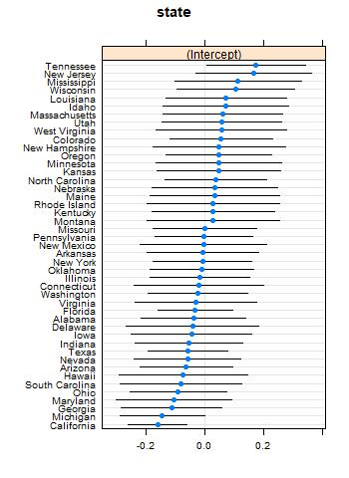
Results and Future Work
Results
Tennessee has the largest estimated intercept
n = 57
California has the lowest estimated intercept
n = 259
Future work
Interactions
Attempt to address violated assumptions

